Slide 1
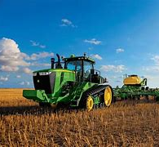

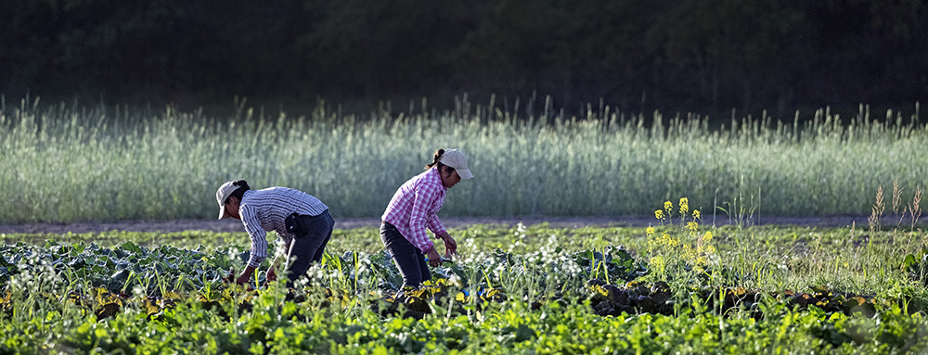

Local Working Group
Training Session
By: Association of Florida Conservation Districts
July 26, 2022

Slide 2





What is a Local Working Group?
Local Working Groups are composed of agricultural producers, owners/operators of nonindustrial private forest land, professionals representing agricultural and natural resource interests, and individuals representing a variety of disciplines in the soil, water, wetland, plant, forestry, and wildlife sciences who are familiar with agricultural and natural resource issues in the local community.

Slide 3

Why is a Local Working Group Important?
Local Working Groups provide recommendations to the District Conservationist, State Technical Committee and the State Conservationist on local natural resource priorities and criteria for conservation activities and programs.

Slide 4
Role of the Soil & Water Conservation District (SWCD)
Assemble the local work group and set agenda
Conduct the local work group meeting
Provide / share results from prior FY local work group meeting
Acquire input from community stakeholders in the form of a conservation needs assessment
Complete the local work group questionnaire as one entity

Slide 5
Role of the Association of Florida Conservation Districts (AFCD)
Assist Districts/NRCS with scheduling the LWG Meeting (October – November)
Provide a Zoom link for each LWG meeting
Publicly notice each LWG meeting (30 days in advance)
Provide LWG questionnaire
Submit questionnaire responses to NRCS by established deadline

Slide 6
Role of Natural Resources Conservation Service (NRCS)
In the event the SWCD is unable to organize the LWG meting, the District Conservationist in that county will be responsible for that duty
Assist with identifying members for the Local Work Group
Help identify program priorities and resources available
Support and advise the Local Work Group concerning technical issues, program policies and procedures, and other matters relating to conservation program delivery
Post LWG meeting details on the NRCS website 30 days in advance
Provide LWG summary report to the State Technical Committee meeting
Provide final agency decisions for the following fiscal year program and natural resource priorities at the State Technical Committee meeting

Slide 7
Participation
Local Working Group participants should be diverse and focus on agricultural interests and natural resource issues existing in the local community. To ensure that recommendations of the Local Working Group take into account the needs of diverse groups served by USDA, participants shall include to the extent possible: individuals with demonstrated ability to represent the conservation concerns of particular historically underserved groups and individuals including, but not limited to, minorities; women; persons with disabilities; and socially and economically disadvantaged groups.
Individuals or groups wanting to become a participant of a Local Working Group may submit to the Local Working Group Chairperson and the NRCS District Conservationist, a request that explains their interest and outlines their credentials for becoming a member of the Local Working Group. The District Conservationist will assist the soil and water conservation district in making decisions concerning participation of the group.
Local Working Group meetings are open to the public. Individuals attending the Local Working Group meetings will be given the opportunity to address the Local Working Group and provide input.

Slide 8

Conducting Business
The meetings will be facilitated to foster open discussion among members. Discussion will focus on identifying local natural resource concerns and priorities that can be addressed through USDA NRCS Programs and corresponding conservation practices. The members will then complete the Local Working Group Survey as one entity, to be submitted to the State Technical Committee and State Conservationist. It is imperative to complete one individual questionnaire per LWG/District in order for the data to be utilized efficiently.
Local Work Group Meeting
F/Y 2024

Slide 9
Local Working Group Responsibilities
Ensure that a conservation needs assessment is developed using community stakeholder input
Identify priority resource concerns that can be addressed by and through USDA NRCS programs
Identify program funding needs and priority conservation practices
Identify high-priority areas that are in greatest need of conservation efforts
Participate in multi-county coordination
Assist NRCS and the SWCD with public outreach and information efforts and identify educational and producers’ training needs

Slide 10
Definitions
What is a conservation needs assessment?
  An analysis of the local natural resources and resource-based land uses needing increased conservation attention.
  The process seeks to objectively and consistently identify priority areas and their conservation needs
Example:
Pastureland- the need to control Tropical Soda Apple or Smut Grass for a cattle operation (increase forage prod.)
Cropland- the need for efficiencies in water conservation through irrigation/micro-irrigation
What is a High Priority Area?
  Geographic areas or watersheds that may need special consideration for funding
Example:
Longleaf Pine Initiative- historic range/restoration efforts

Slide 11
Definitions cont..
What is a USDA (NRCS) Program?
Environmental Quality Incentives Program (EQIP)
Conservation Stewardship Program (CSP)
Agricultural Conservation Easement Program (ACEP)
  Wetland Reserve Easement
  Agricultural Land Easement
What is a resource concern?
Degraded plant condition- excessive plant pest pressure
Example: Large presence of Tropical Soda Apple and associated impact on the overall forage quality and availability

Slide 12
Who should be a Participant?
Staff & Supervisors of your Soil and Water Conservation District (SWCD) -Mandatory
Natural Resources Conservation Service (NRCS) District Conservationist- Mandatory
Association of Florida Conservation Districts (AFCD)- Mandatory
Suggested participants to include but not limited to:
  State Natural Resources Agencies
  Federal Natural Resources Agencies
  FDACS/OAWP
  Florida Forest Service
  Local Cattleman’s Association Members
  UF/IFAS Extension County Agents
  Florida Fish and Wildlife Conservation Commission
  Local Landowners/Farmers/Ranchers/Producers
  Professionals representing agricultural and natural resource interests

Slide 13
Meeting Invitations and Publications
Invitations: Prepare a mailing list or email list of appropriate participants. Send out your invitations as far in advance as possible to help encourage attendance.
Publications: You are required to publicly notice your meeting. You can publicly notice your meeting in your local newspaper or posted at your County offices where publications are posted. You should publish your meeting at least 30 days in advance.

Slide 14
Outreach
Community outreach is one of the best ways to gain participation at your Local Work Group Meeting. Create flyers and post them at your Local County Offices, your District website and/or Facebook page, and anywhere in your County that will catch the attention of producers/landowners/conservationists.

Slide 15
Local Working Group Website
We are working on a LWG page on the AFCD website. Once completed, this will be your one stop shop to all things LWG related. You will have access to the Introductory Packet here along with many other resources to help conduct a successful LWG meeting.
Local Working Groups | Association of Florida Conservation Districts (afcd.us)

Slide 16

Questions

Slide 17
Kaylee Pate
Association of Florida Conservation Districts
Agreements & Outreach Coordinator
Post Office Box 1763
Chiefland, Florida 32644
Kaylee.pate@afcdfl.com
352-221-8531 | Cell
www.afcd.us

