Slide 1
Florida Department of Agriculture and Consumer Services
Office of Agricultural Water Policy
Partnerships
AFCD Annual Meeting
New Supervisor Training
July 11, 2019

Slide 2
Office of Agricultural Water Policy
582.055 Powers and duties of the Department of Agriculture and Consumer Services; rules.—
(1) The provisions of this chapter shall be administered by the Department of Agriculture and Consumer Services.
(2) The department is authorized to receive gifts, appropriations, materials, equipment, lands, and facilities and to manage, operate, and disburse them for the use and benefit of the soil and water conservation districts of the state.
(4) May furnish information and call upon any state or local agencies for cooperation in carrying out the provisions of this chapter.
(5) May offer such assistance as may be appropriate to the supervisors of soil and water conservation districts and facilitate communication and cooperation between districts.
(6) May seek the cooperation and assistance of any federal, state, or county agencies in the work of such districts, including the receipt and expenditure of state, federal, and other funds or contributions.
(7) May disseminate information throughout the state concerning the activities, research, and programs of the soil and water conservation districts and encourage the formation of such districts in areas where their organization is desirable.
(8) May create or dissolve a soil and water conservation district pursuant to the provisions of this chapter.
(9) May adopt rules, as necessary, to implement the provisions of this chapter.
History.—s. 2, ch. 70-392; s. 44, ch. 98-34; s. 86, ch. 2013-18; s. 25, ch. 2016-61.
Notes:
Bullet One:
Water quality and water conservation
Economic and technical consideration
BMPs are verified by FDEP for each manual
Verify with electronic system, Staff assisted and actual Site Visits
Work Cooperatively With
Agricultural producers, industry groups, state and regional agencies
Department of Environmental Protection
State University System
Five water management districts

Slide 3
582.20 Powers of districts and supervisors.—A soil and water conservation district organized under the provisions of this chapter shall constitute a governmental subdivision of this state, and a public body corporate and politic, exercising public powers, and such district and the supervisors thereof shall have the following powers, in addition to others granted in other sections of this chapter:
(3) To cooperate, or enter into agreements with, any special district, municipality, county, water management district, state or federal agency, governmental or otherwise, or owner or occupier of lands within the district’s boundaries, within another district’s boundaries subject to the other district’s approval, or not contained within any district’s boundaries in furtherance of the purposes and provisions of this chapter;
(9) To use, in coordination with the applicable county or counties, the services of the county agricultural agents and the facilities of their offices, if practicable and feasible. The supervisors may also employ additional permanent and temporary staff, as needed, and determine their qualifications, duties, and compensation. The supervisors may delegate to the chair, to one or more supervisors, or to employees such powers and duties as they may deem proper, consistent with the provisions of this chapter. The supervisors shall furnish to the department, upon request, copies of rules, orders, contracts, forms, and other documents that the district has adopted or used, and any other information concerning the district’s activities, that the department may require in the performance of its duties under this chapter;
Notes:
Bullet One:
Water quality and water conservation
Economic and technical consideration
BMPs are verified by FDEP for each manual
Verify with electronic system, Staff assisted and actual Site Visits
Work Cooperatively With
Agricultural producers, industry groups, state and regional agencies
Department of Environmental Protection
State University System
Five water management districts

Slide 4
Partnering Agencies
FDACS
NRCS
UF – IFAS
WMDs
Local Government
Notes:
Bullet One:
Water quality and water conservation
Economic and technical consideration
BMPs are verified by FDEP for each manual
Verify with electronic system, Staff assisted and actual Site Visits
Work Cooperatively With
Agricultural producers, industry groups, state and regional agencies
Department of Environmental Protection
State University System
Five water management districts

Slide 5
Partnering Agencies cont.
FDACS – OAWP
  SWCDs
    Technicians
    Cost share
    MIL
  Other Divisions
  AFCD

Slide 6
Partnering Agencies cont.
Natural Resources Conservation Service
UF-IFAS
Water Management Districts
Florida Department of Environmental Protection
Local Government
Others?

Slide 7
SWCD Partnering Examples
Istokpoga Marsh
Suwannee County Conservation District
Others?

Slide 9

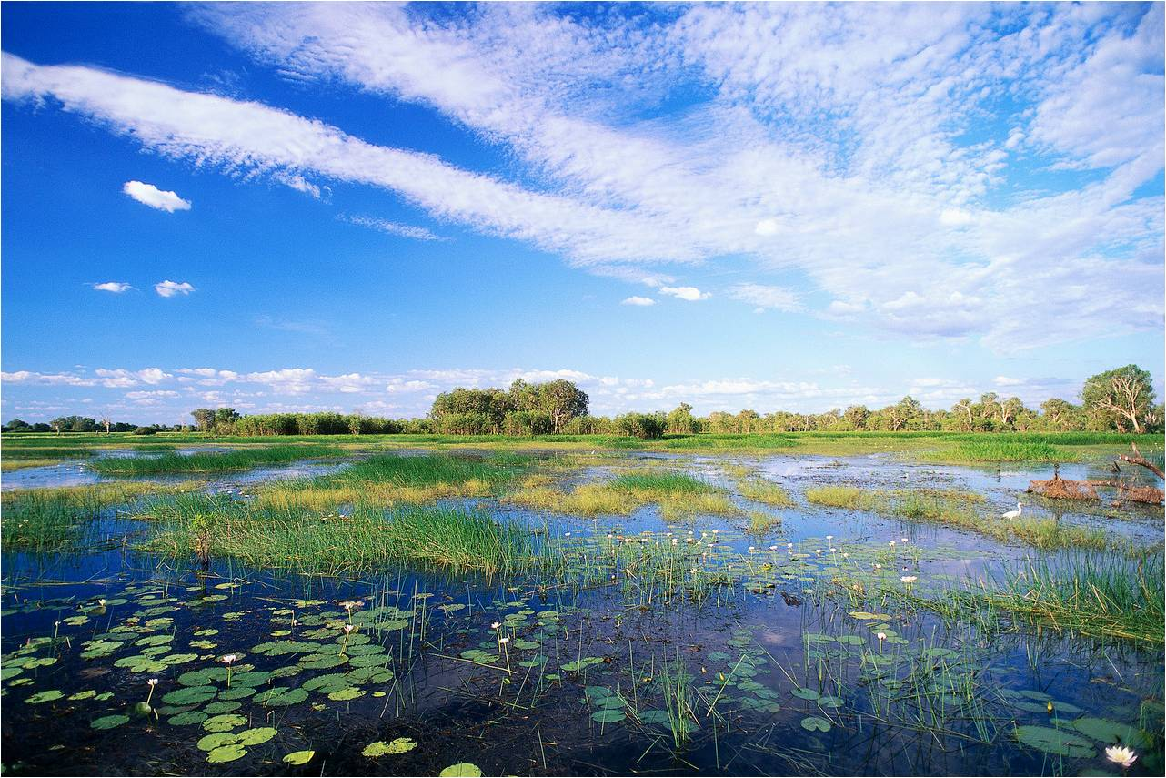
Thank You!
http://www.freshfromflorida.com/Divisions-Offices/Agricultural-Water-Policy
Clegg Hooks, Deputy Director
(850)617-1700
Clegg.Hooks@FreshFromFlorida.com

